Slide 1
Algorithms
Lecture #04
Dr.Sohail Aslam

Slide 2
Example – 2 dimension maxima

Slide 3
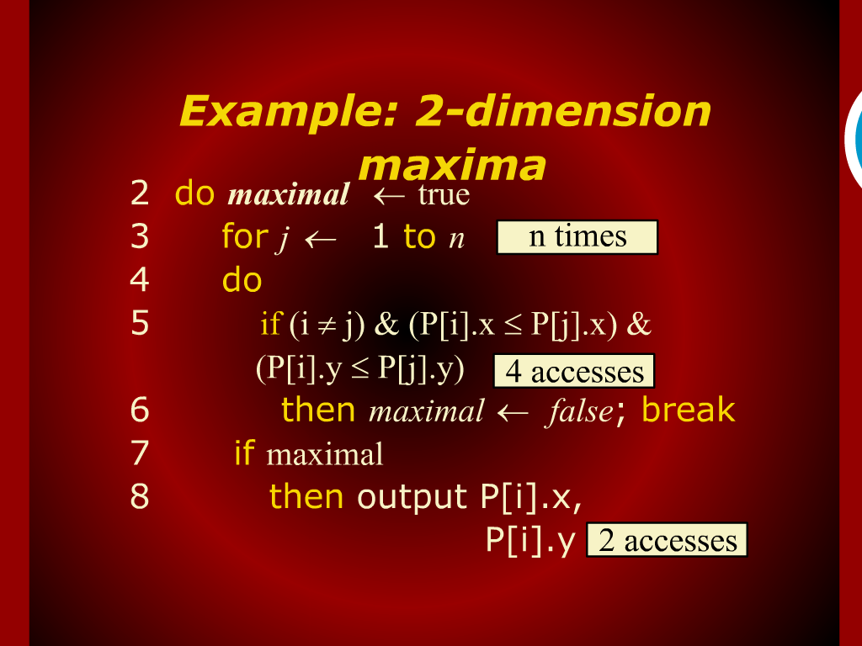
Example: 2-dimension maxima

Slide 4
2 dimension maxima Revisited

Slide 5
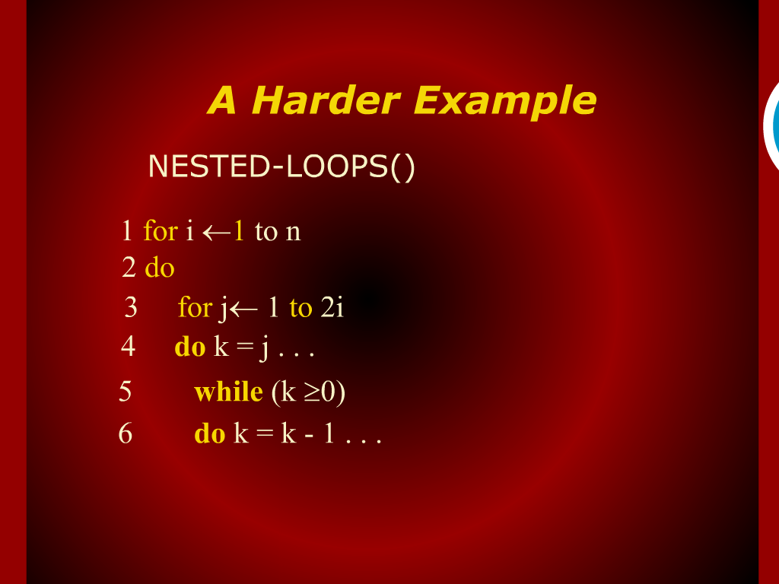
A Harder Exmaple

Slide 6
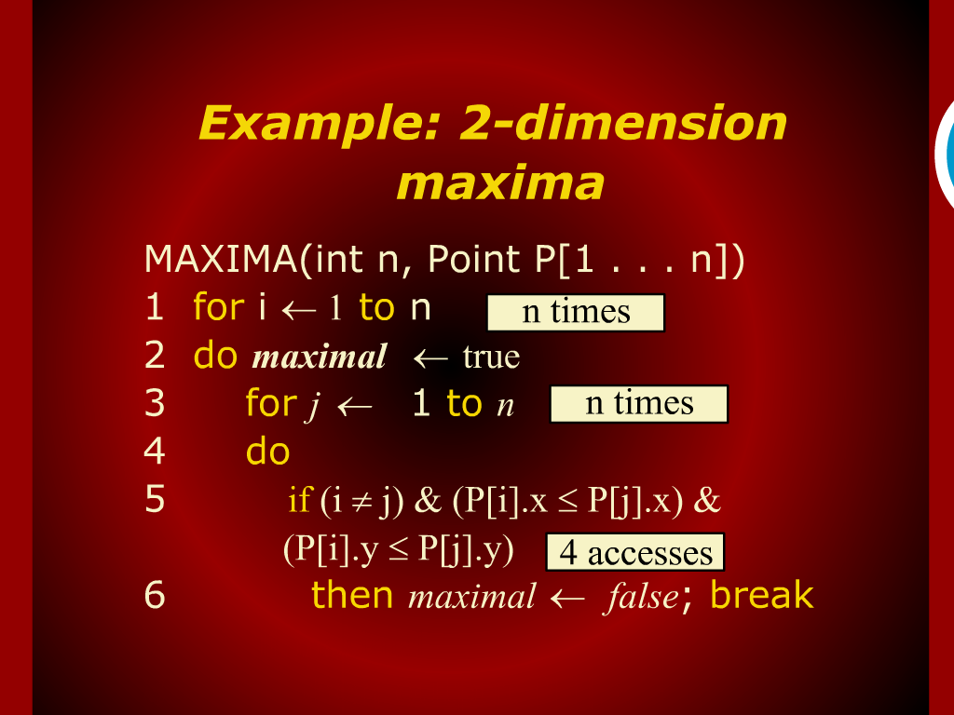
Example: 2-dimension maxima

Slide 7
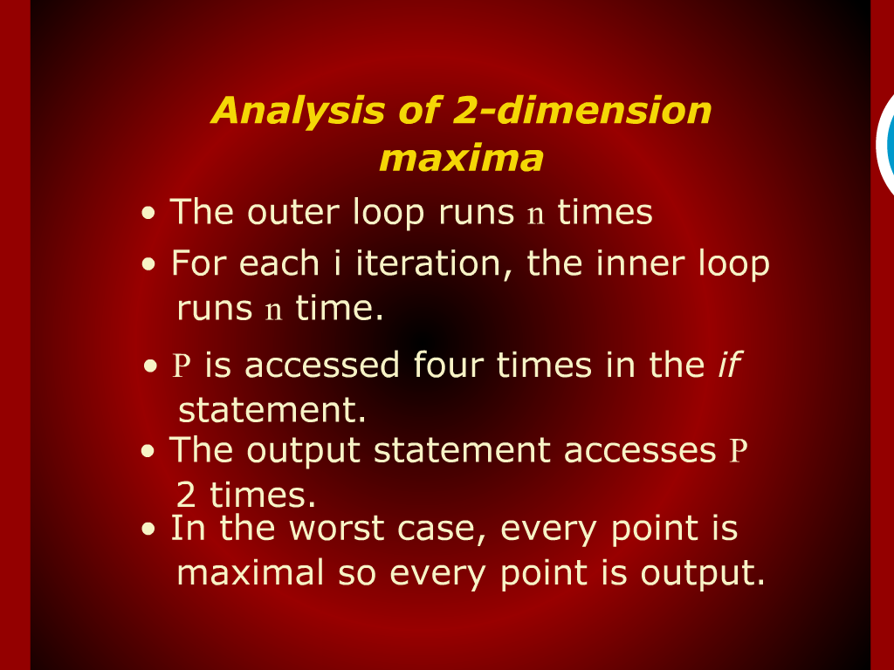
Analysis of 2-dimension maxima

Slide 8
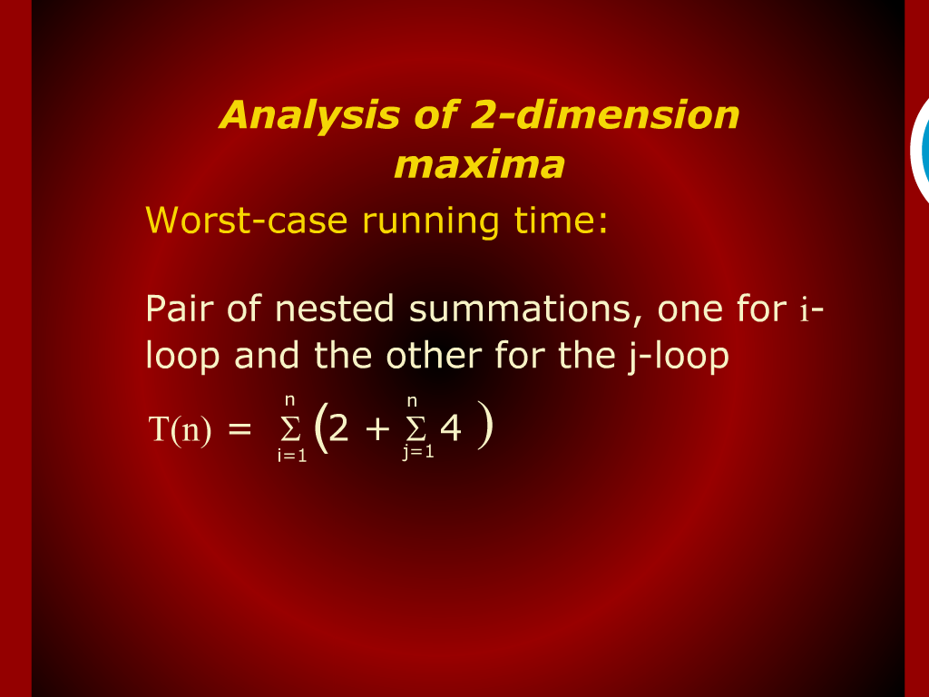
Analysis of 2-dimension maxima

Slide 9
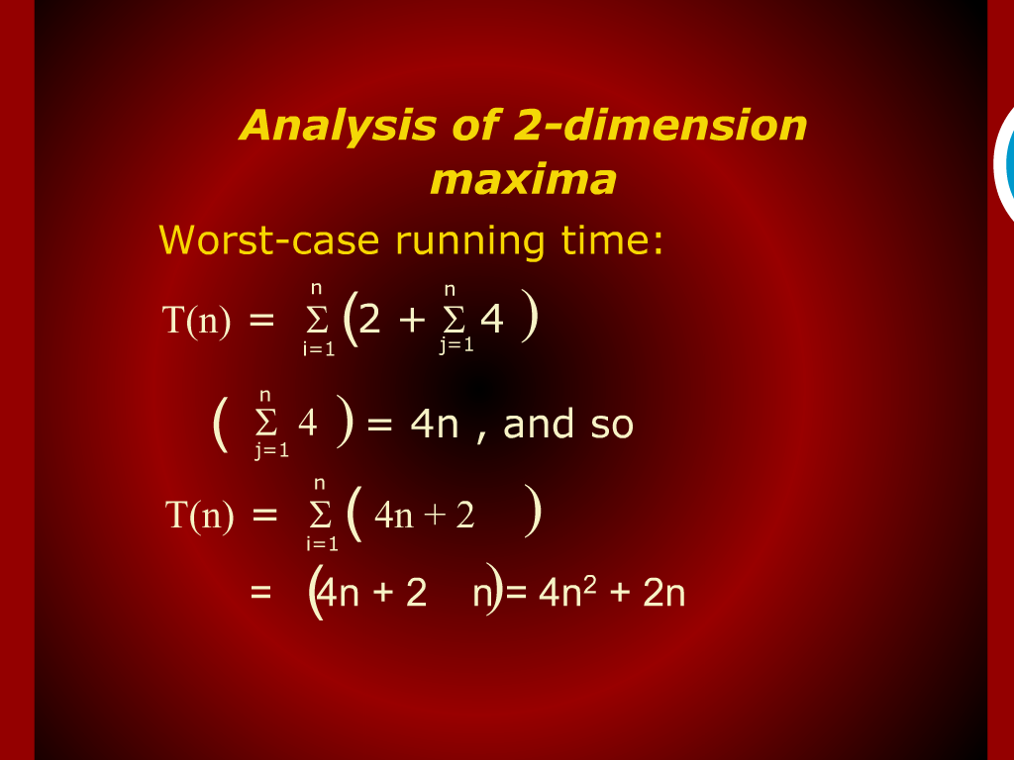
Analysis of 2-dimension maxima

Slide 10
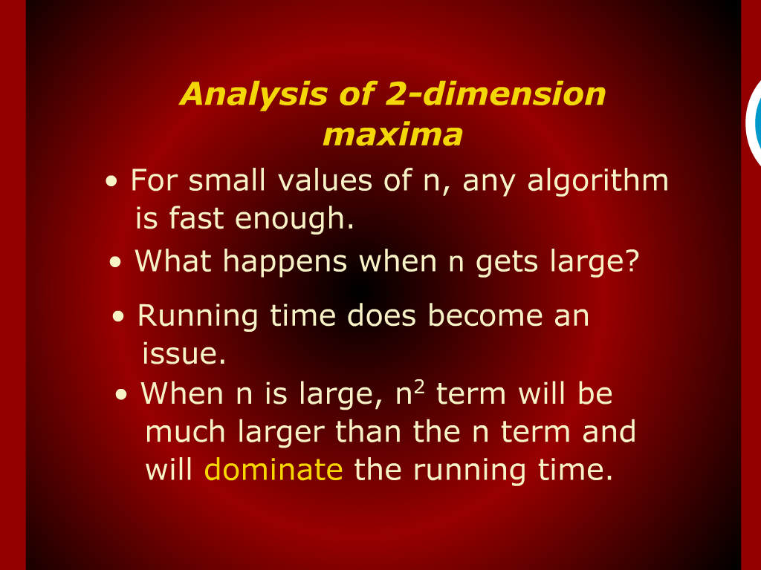
Analysis of 2-dimension maxima

Slide 11
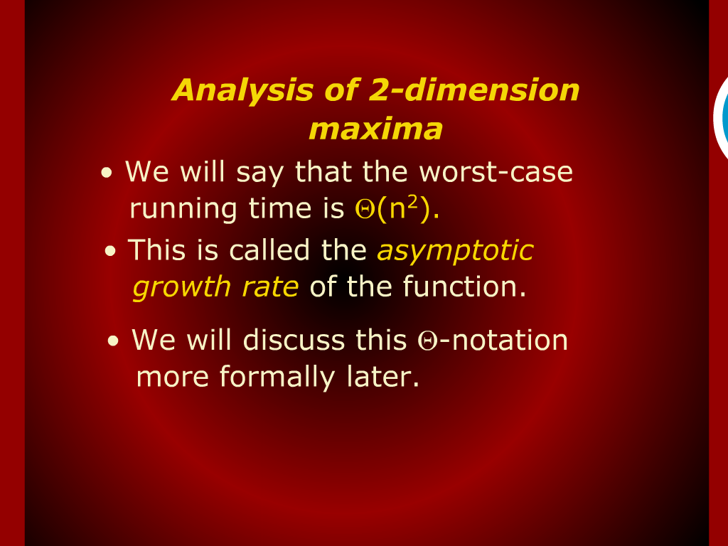
Analysis of 2-dimension maxima

Slide 12
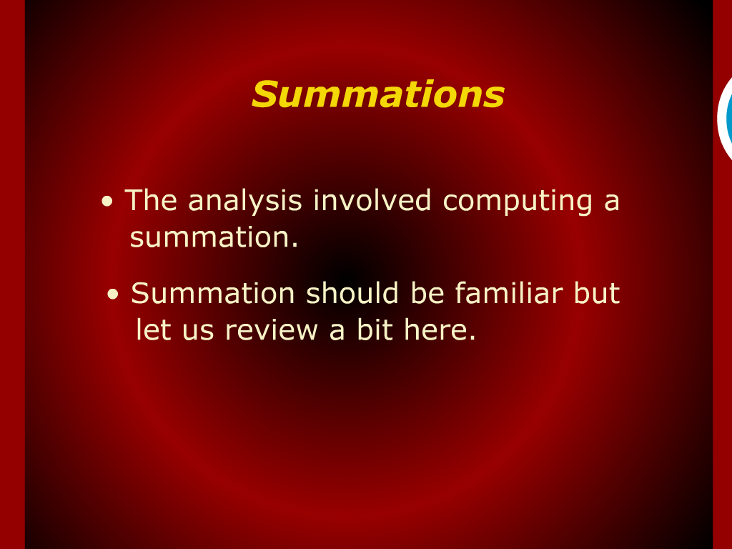
Summations

Slide 13
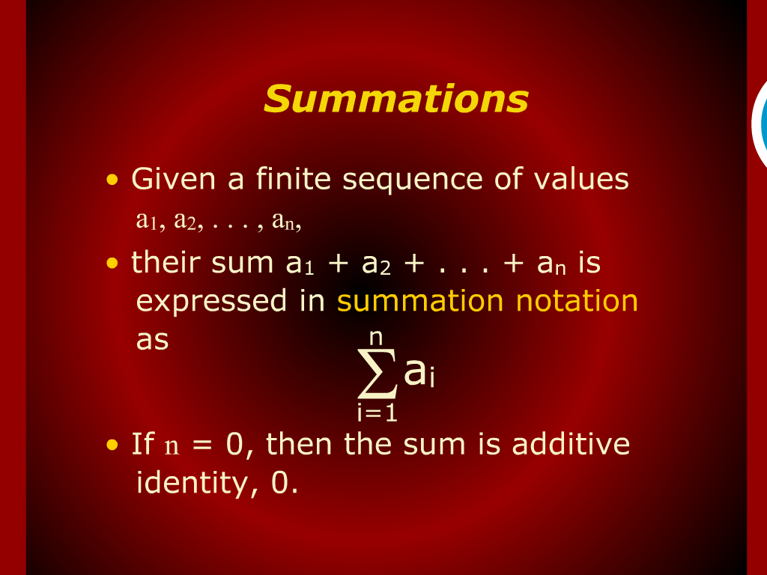
Summations

Slide 14
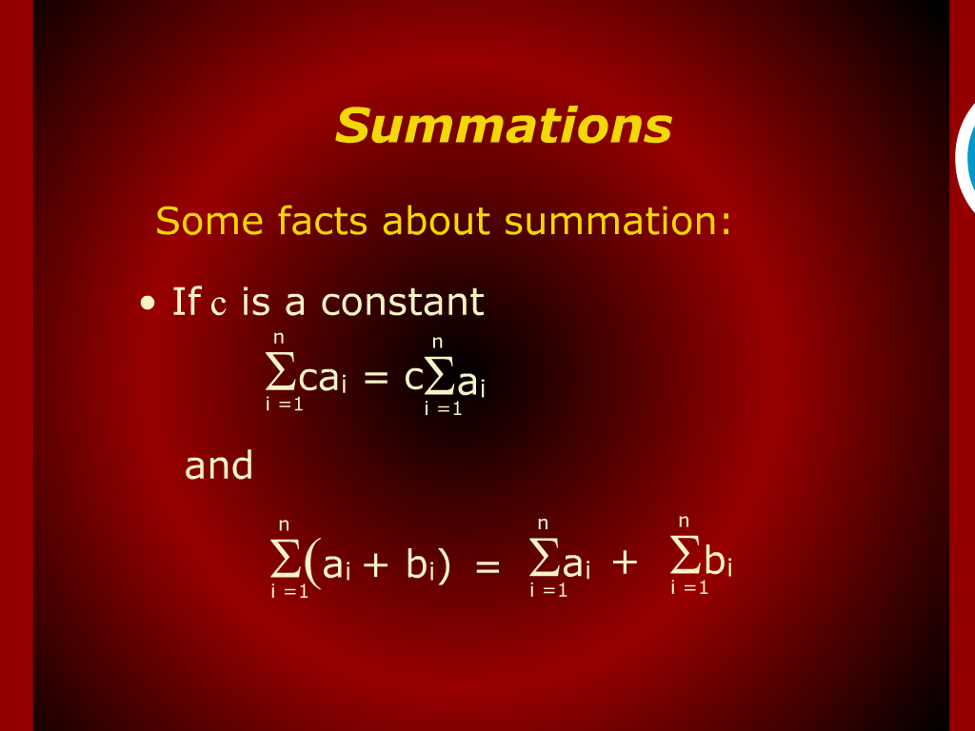
Summations

Slide 15
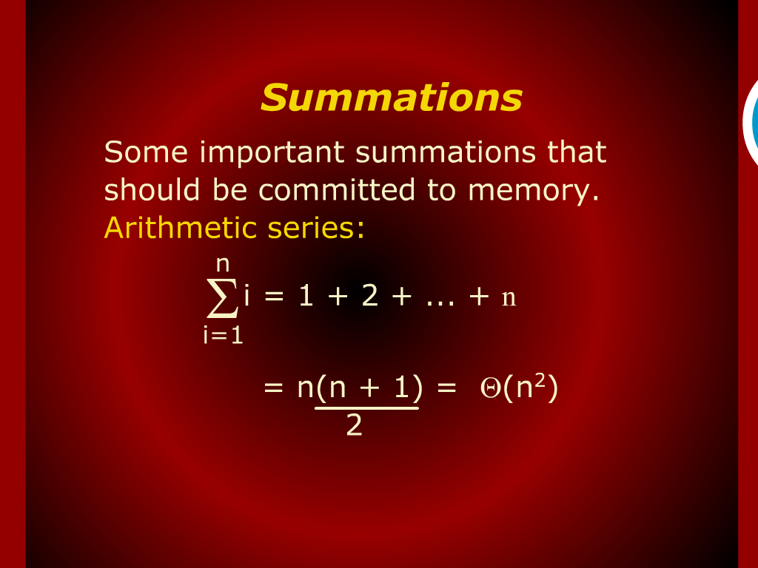
Summations

Slide 16
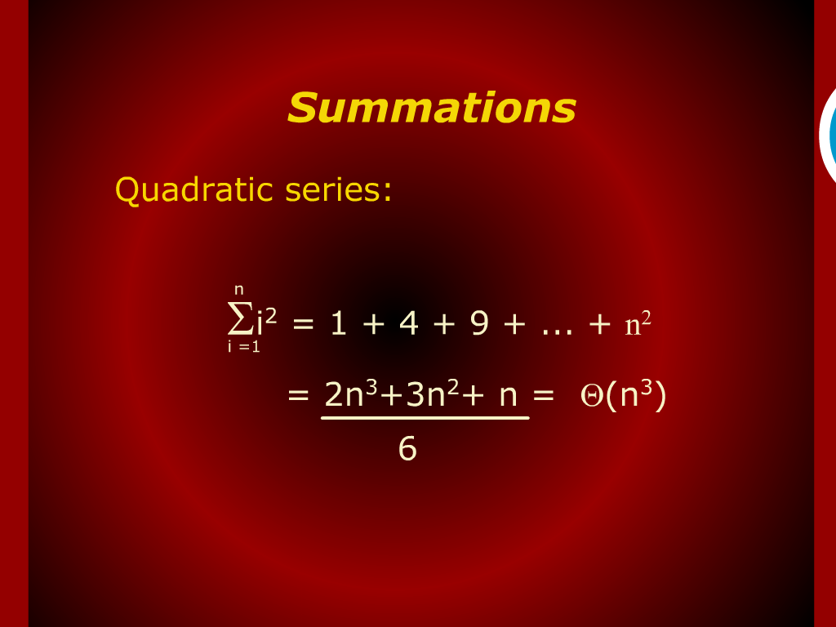
Summations

Slide 17
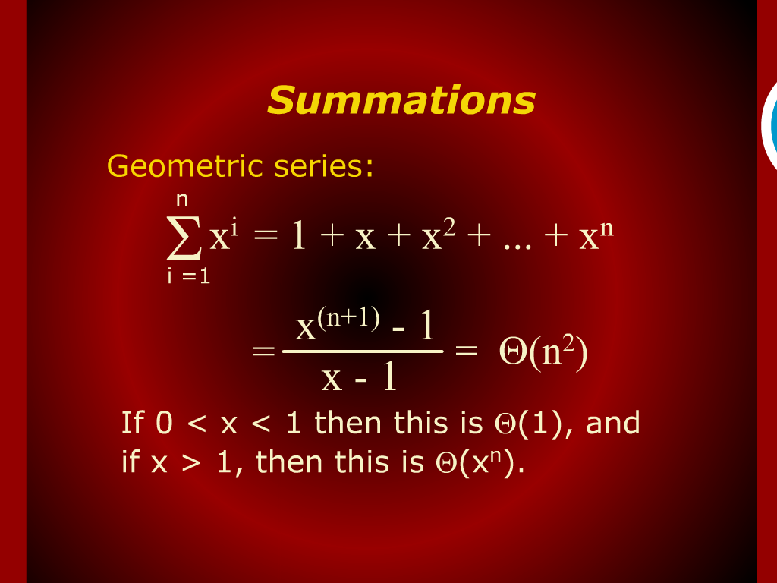
Summations

Slide 18
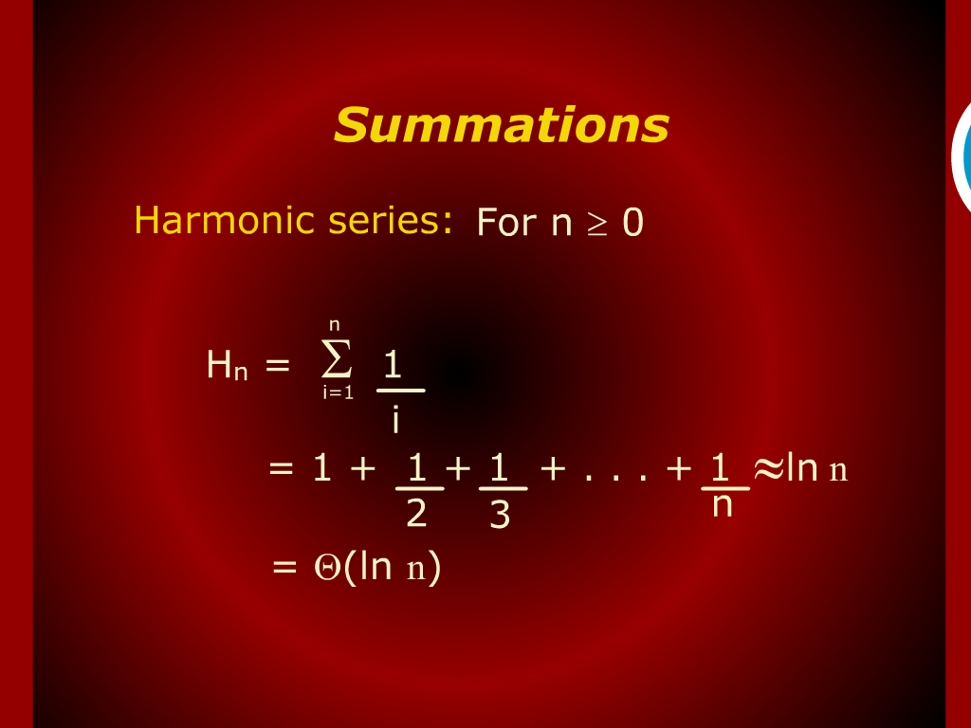
Summations

Slide 19
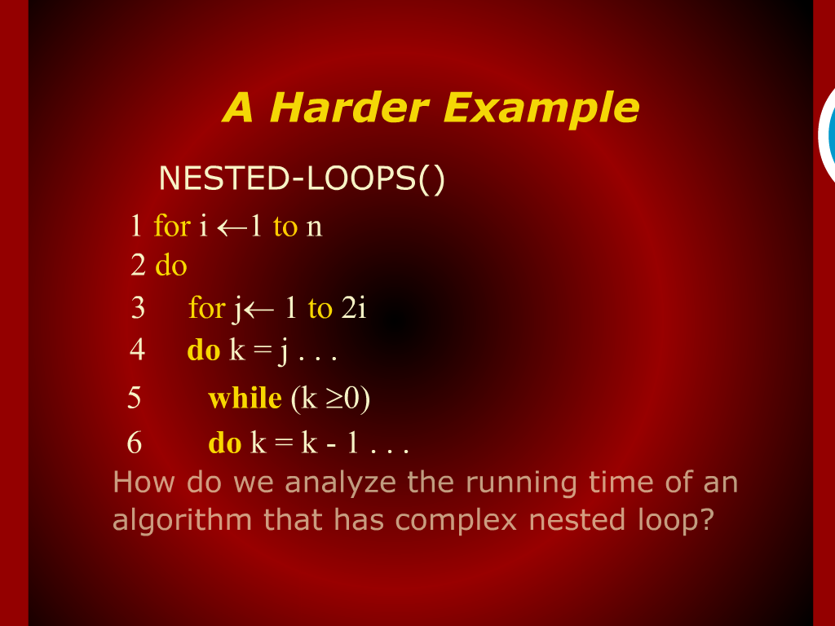
A harder Example

Slide 20
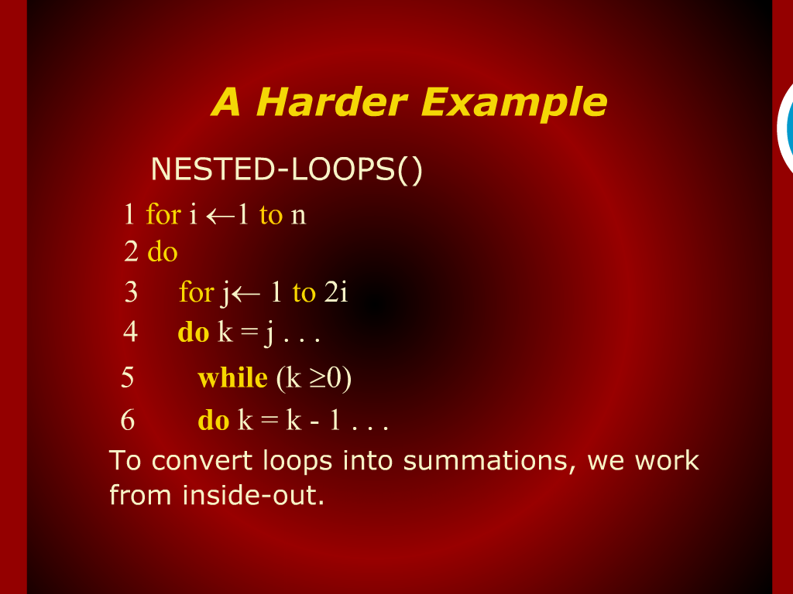
A harder Example

Slide 21
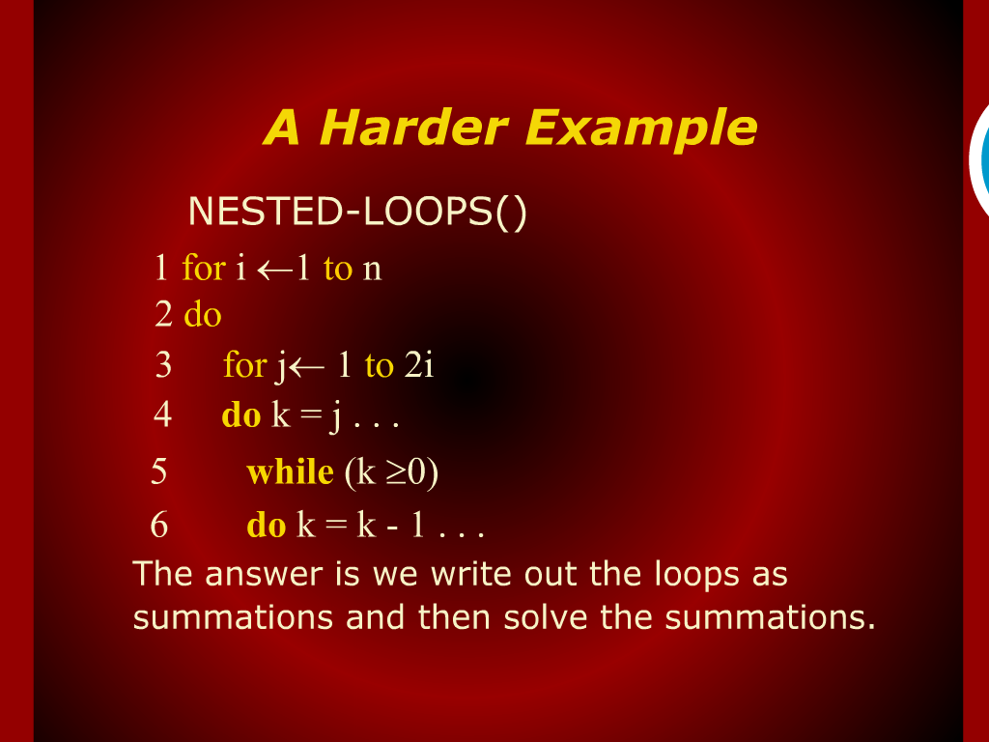
A harder Example

Slide 22
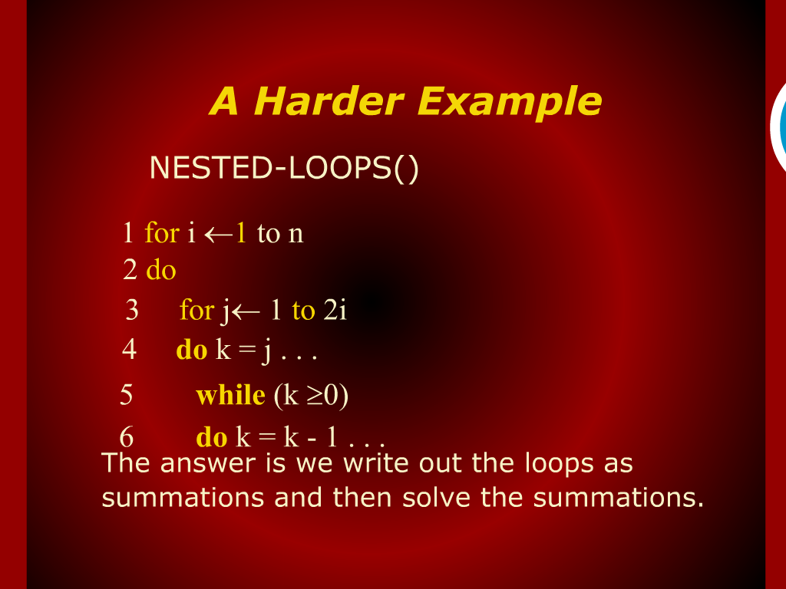
A harder Example

Slide 23
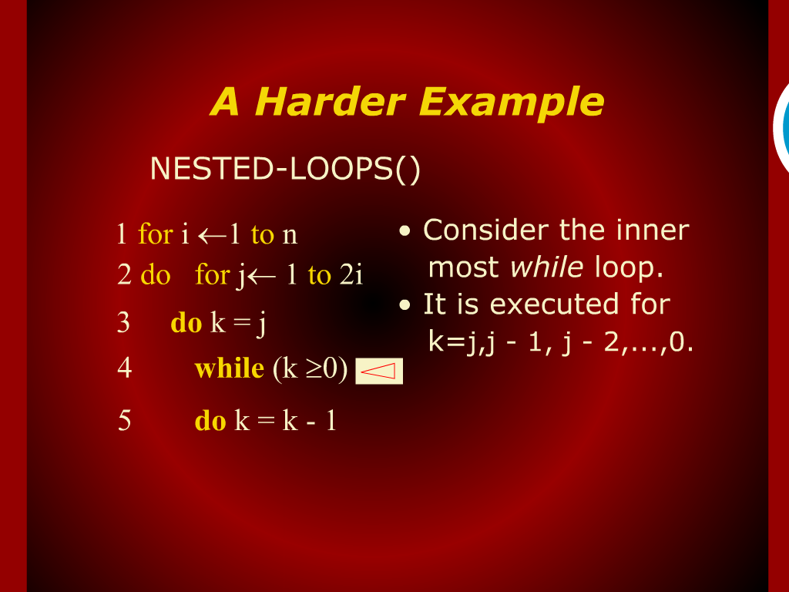
A harder Example

Slide 24
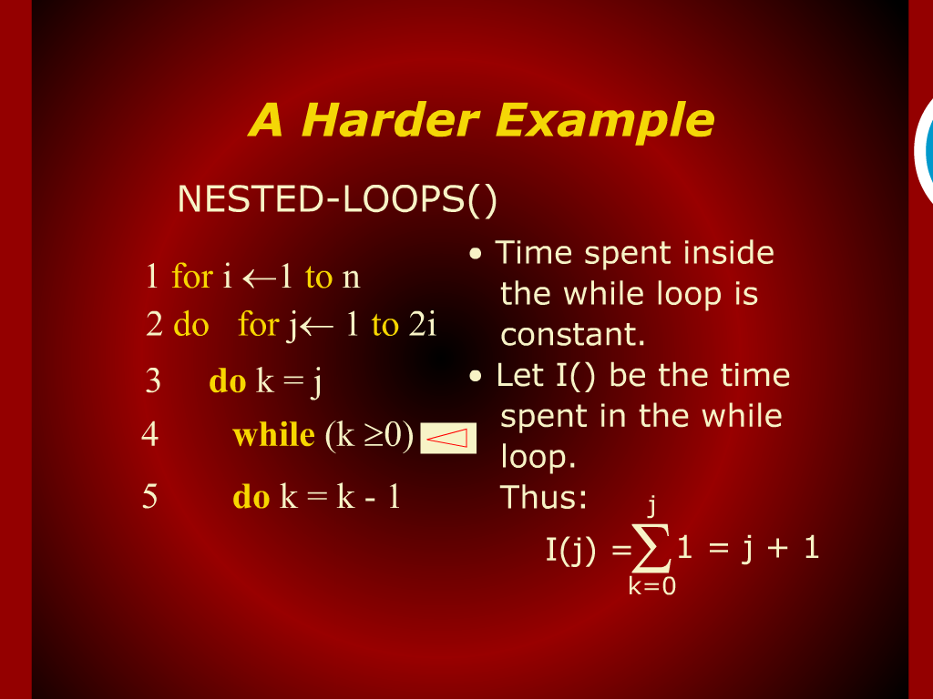
A harder Example

Slide 25
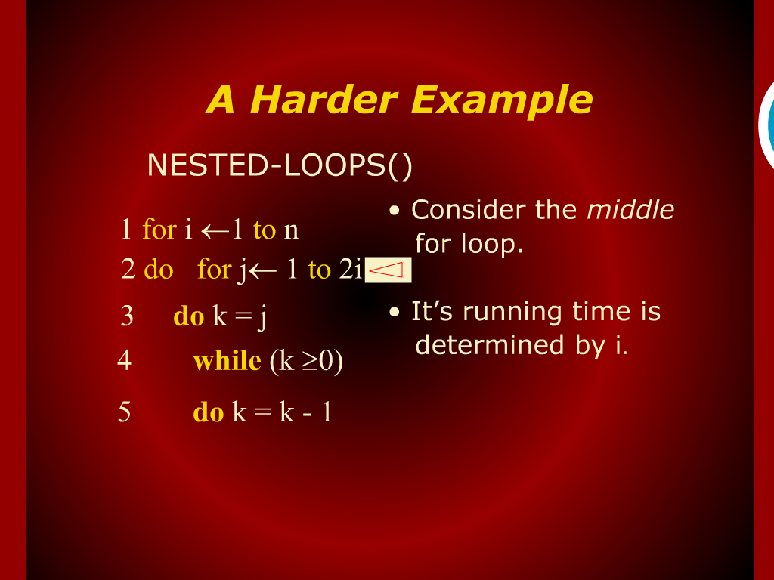
A harder Example

Slide 26
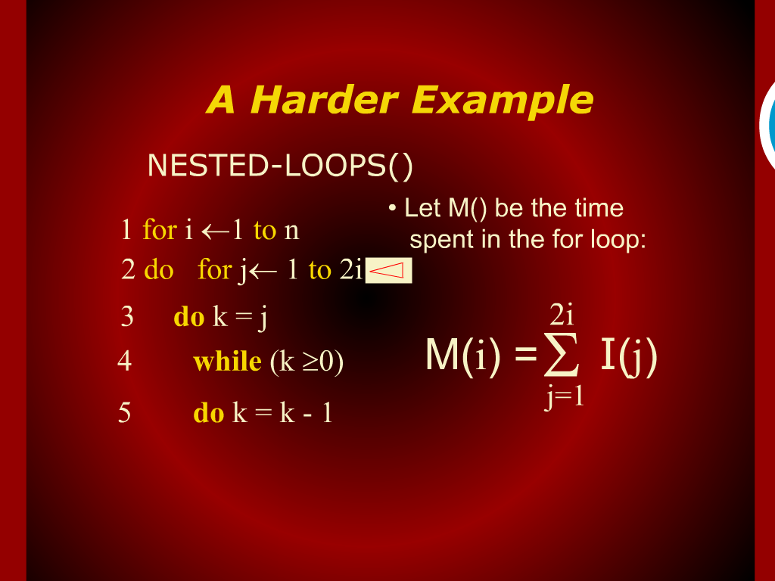
A harder Example

Slide 27
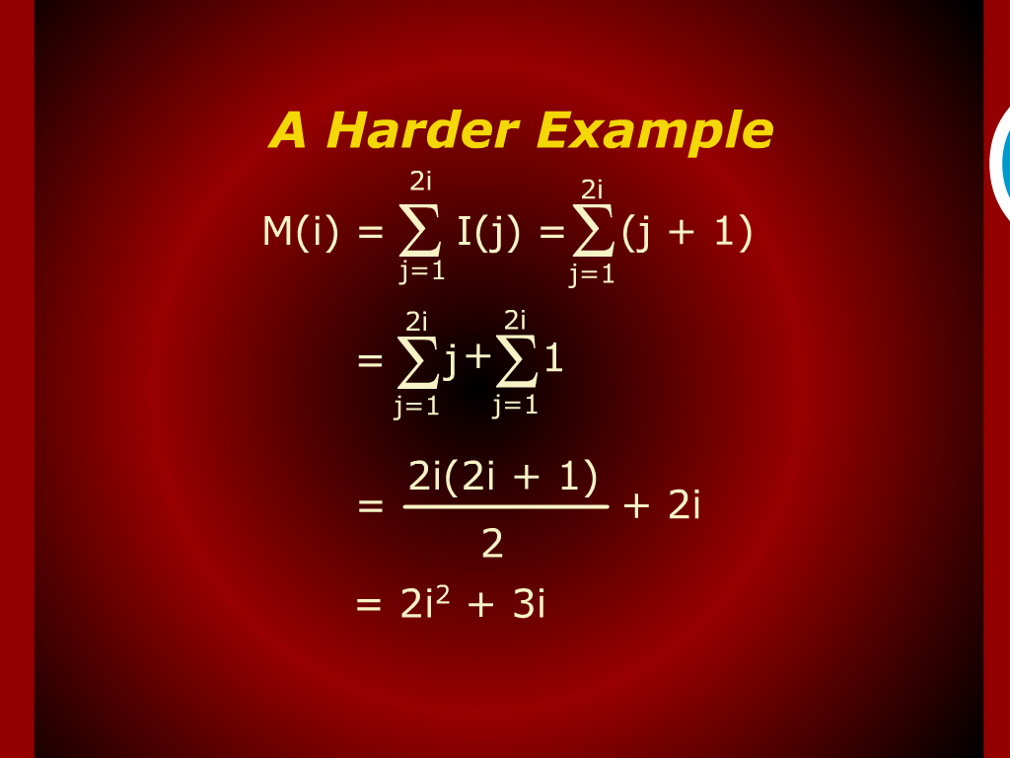
A harder Example

Slide 28
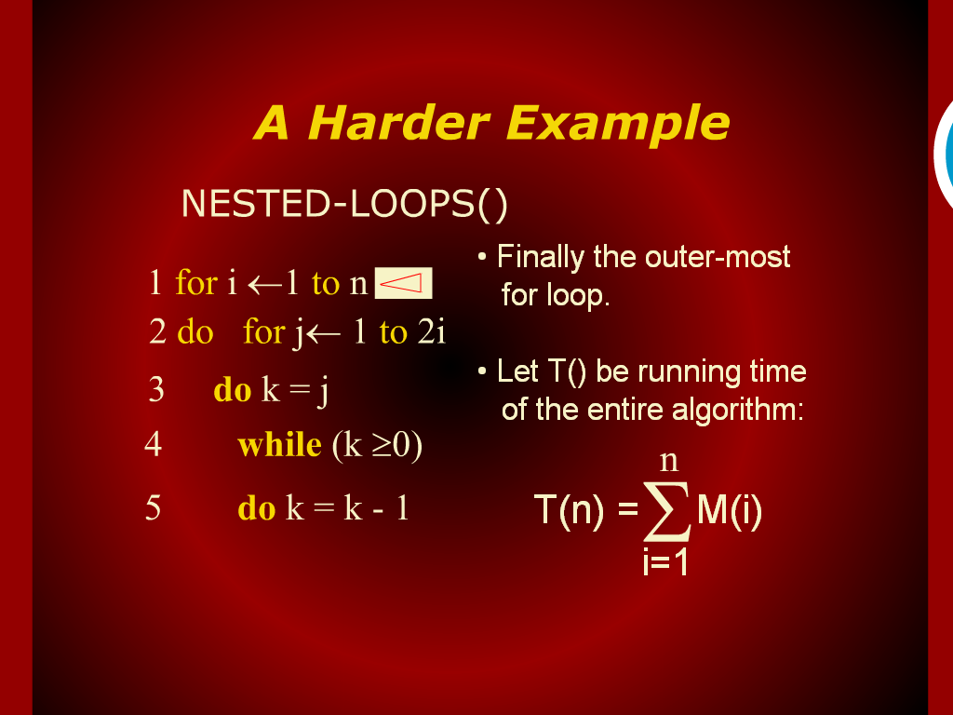
A harder Example

Slide 29
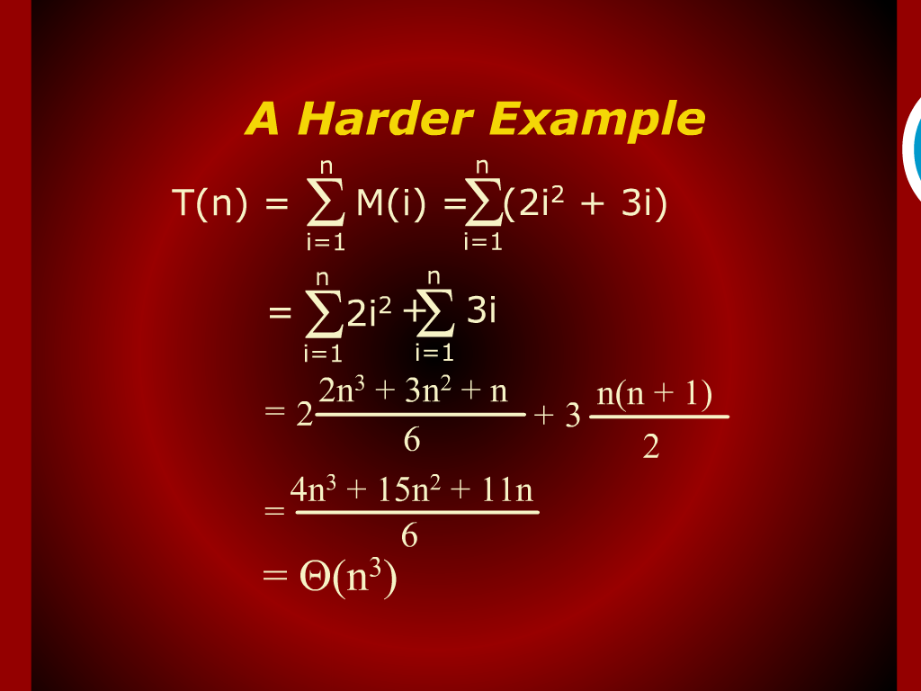
A harder Example

Slide 30
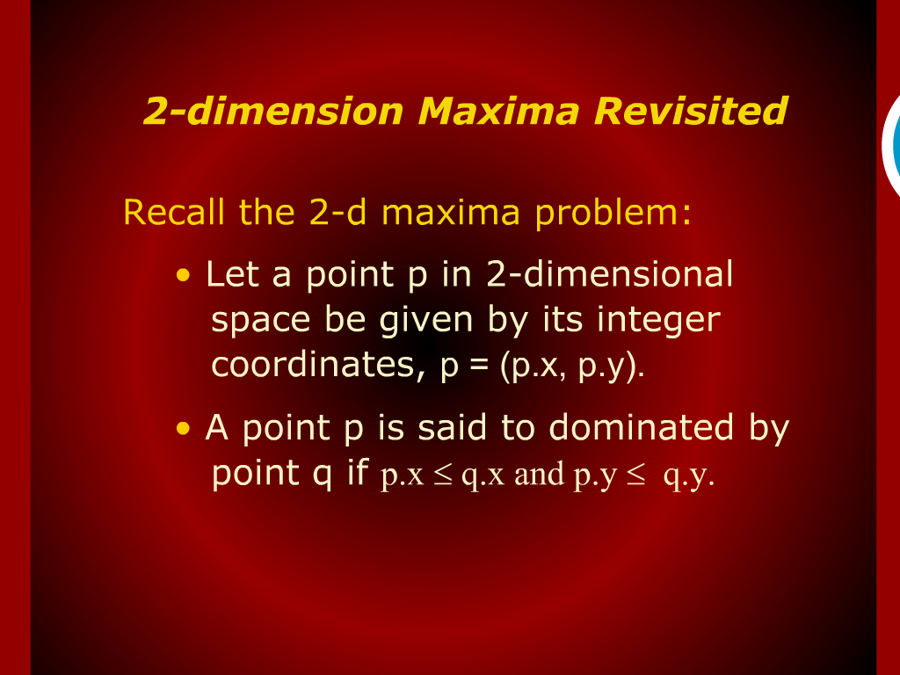
2-dimension Maxima Revisited

